Slide 1
Summarising data
Numerical summaries of data

Slide 2
how to use Oak lessons

Slide 3
I can see that the different measures of central tendency offer a summary of a set of data.

Slide 4
data
mean
median
mode
measure of central tendency

Slide 5
Data are a collection of information.
The (arithmetic) mean for a set of numerical data is the sum of the values divided by the number of values. It is a measure of central tendency representing the average of the values.
The median is the central (middle) piece of data when the data are in numerical order.
Mode is the most frequent value. It is a measure of central tendency representing the average of the values.
A measure of central tendency is a summary measure that attempts to describe a whole set of data with a single value that represents the middle or centre of its distribution.

Slide 6

Summarising data
Calculating all of the averages
Dealing with an unrepresentative mean
Dealing with an unrepresentative median or mode

Slide 7
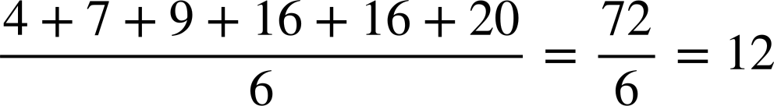
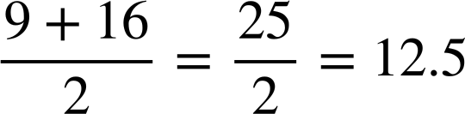
Calculating all of the averages
All averages are methods of summarising a data set.
The measures of central tendency (the mean, median, and mode) all aim to summarise the data set with a single value that represents the centre of its distribution.
4 | 7 | 9 | 16 | 16 | 20
mean:
4 | 7 | 9 | 16 | 16 | 20
median:
4 | 7 | 9 | 16 | 16 | 20
mode: the most frequent number is 16

Slide 8


Calculating all of the averages
Which of these numbers is the mode of this data set?
13 | 15 | 15 | 18 | 20 | 20 | 25
a
12
b
13
c
15
d
17.5
e
20
If a data set has two modes, it is called bimodal.
You keep both modes; you do not find the middle of them (like you do with the median).

Slide 9
Calculating all of the averages
1) Complete the tables showing the mean, median, and mode for the following data sets.
a)
1 | 1 | 1 | 3 | 7 | 10
mean | 3.83 | median |  | mode
b)
14 | 23 | 24 | 25 | 27 | 27 | 28
mean |  | median |  | mode | 27
c)
2.5 | 3.5 | 4 | 5.5 | 7 | 7 | 8.5 | 8.5
mean |  | median | 6.25 | mode

Slide 10
Calculating all of the averages
2) Calculate the mean, median, and mode of these three data sets.
a)
2.5 | 2.5 | 4 | 9 | 10.5
mean |  | median |  | mode
b)
15 | 18 | 20 | 20 | 23 | 24
mean |  | median |  | mode
c)
4 | 4 | 4 | 5 | 7 | 7 | 7 | 8 | 8
mean |  | median |  | mode
3) For question 2, which of the data sets was the odd one out? Justify your answer.

Slide 11
Calculating all of the averages
1) Complete the information showing the mean, median, and mode for the following data sets.
a)
1 | 1 | 1 | 3 | 7 | 10
mean | 3.83 | median | 2 | mode | 1
b)
14 | 23 | 24 | 25 | 27 | 27 | 28
mean | 24 | median | 25 | mode | 27
c)
2.5 | 3.5 | 4 | 5.5 | 7 | 7 | 8.5 | 8.5
mean | 5.81 | median | 6.25 | mode | bimodal at 7 and 8.5

Slide 12
Calculating all of the averages
2) Calculate the mean, median, and mode of these three data sets.
a)
2.5 | 2.5 | 4 | 9 | 10.5
mean | 5.7 | median | 4 | mode | 2.5
b)
15 | 18 | 20 | 20 | 23 | 24
mean | 20 | median | 20 | mode | 20
c)
4 | 4 | 4 | 5 | 7 | 7 | 7 | 8 | 8
mean | 6 | median | 7 | mode | bimodal at 4, 7

Slide 13
Calculating all of the averages
3) For question 2, which of the data sets was the odd one out? Justify your answer.
There are many possible responses, including:
b) is the only data set where the mean, median, and mode are all the same.
c) is the only data set where the mode is bimodal.
a) is the only data set where the mean and mode are decimals.

Slide 14
Summarising data
Calculating all of the averages
Dealing with an unrepresentative mean
Dealing with an unrepresentative median or mode

Slide 15
Dealing with an unrepresentative mean
The mean can be a useful representation of the data set when:
the mean lies close to groups of common values (as the mean can represent a typical value in a data set)
or if the mean lies towards the centre of the values in a data set (as the mean is a measure of central tendency)

Slide 16
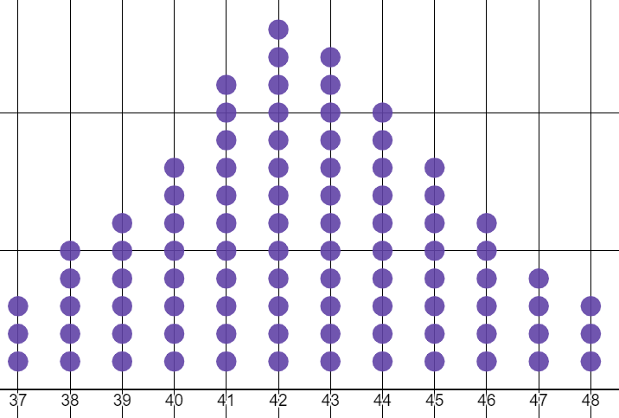
Dealing with an unrepresentative mean
This data set is represented on a dot plot.
The mean of this data set is approximately 42.4
The mean of 42.4 is a representative summary of this data set, as it both:
lies close to other common data points
is located close to the centre of the data set
42
43

Slide 17
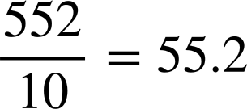
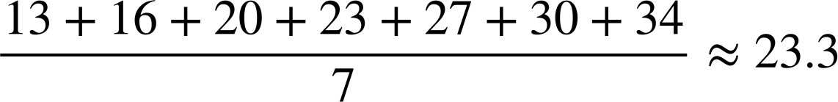
Dealing with an unrepresentative mean
The mean can also be a useful summary if calculated from raw data.
13 | 16 | 20 | 23 | 27 | 30 | 34
49 | 50 | 50 | 52 | 53 | 53 | 56 | 56 | 56 | 77
Whilst the mean of 55.2 isn’t as central, it is still close to groups of common data points: the 53 and 56.
55.2 is a representative summary of the data set.
The mean of 23.3 is a representative summary of the data, as its value is close to the centre of the data set.

Slide 18
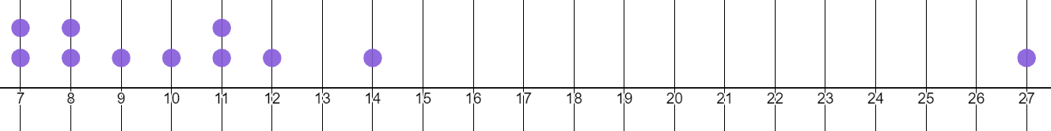
Dealing with an unrepresentative mean
This data set has one or two extremely large values.
7 | 7 | 8 | 8 | 9 | 10 | 11 | 11 | 12 | 14 | 27 | 49
The dot plot represents the same data set as the list of numbers… But the number 49 is so extreme, it couldn’t even fit on the plot!
The mean is neither central nor anywhere near many data points.

Slide 19
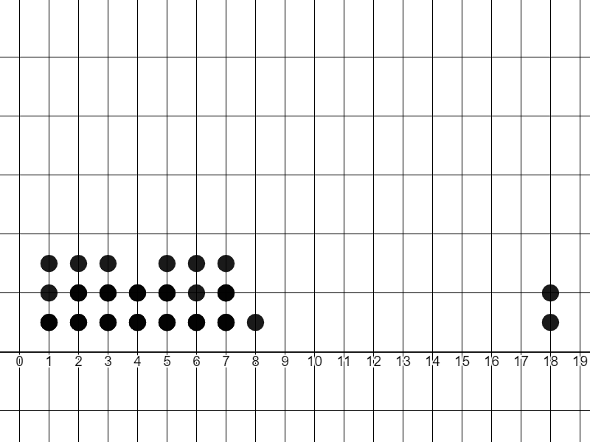
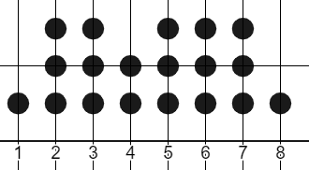

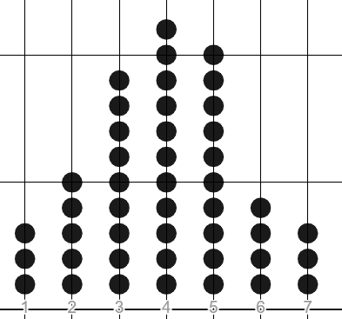
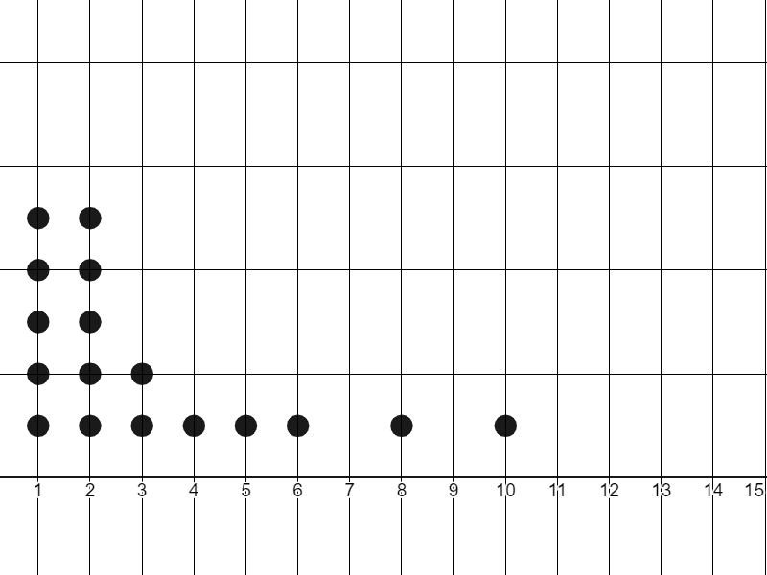
Dealing with an unrepresentative mean
In which of these dot plots would the mean be a representative average?
mean = 4.8
a
mean = 4.5
b
mean = 4
mean = 4.5
c
d

Slide 20
Dealing with an unrepresentative mean
In which of these small data sets would the mean be a suitable average (or measure of central tendency)?
a
1 | 2 | 3 | 3 | 4 | 4 | 5 | 5 | 6 | 7 | 8 | 8
mean = 4.7
b
1 | 1 | 1 | 1 | 1 | 1 | 1 | 12 | 19 | 19 | 20 | 21
mean = 8.2
c
1 | 1 | 4 | 4 | 7 | 7 | 10 | 13 | 13 | 16 | 17 | 20
mean = 9.4
d
1 | 42 | 43 | 43 | 44 | 44 | 44 | 45 | 45 | 47 | 47 | 47
mean = 41
Whilst b is fairly central, it is very far away from any data points.
d is definitely not central, and it is far away from common data points of 44 and 47.

Slide 21
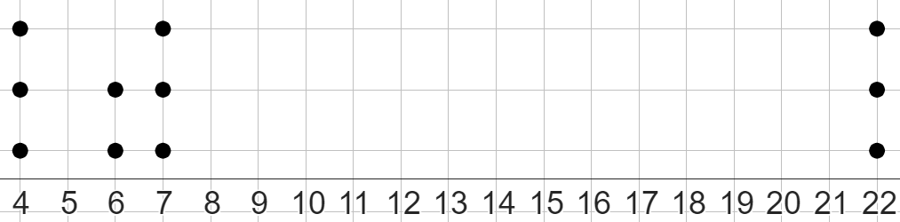
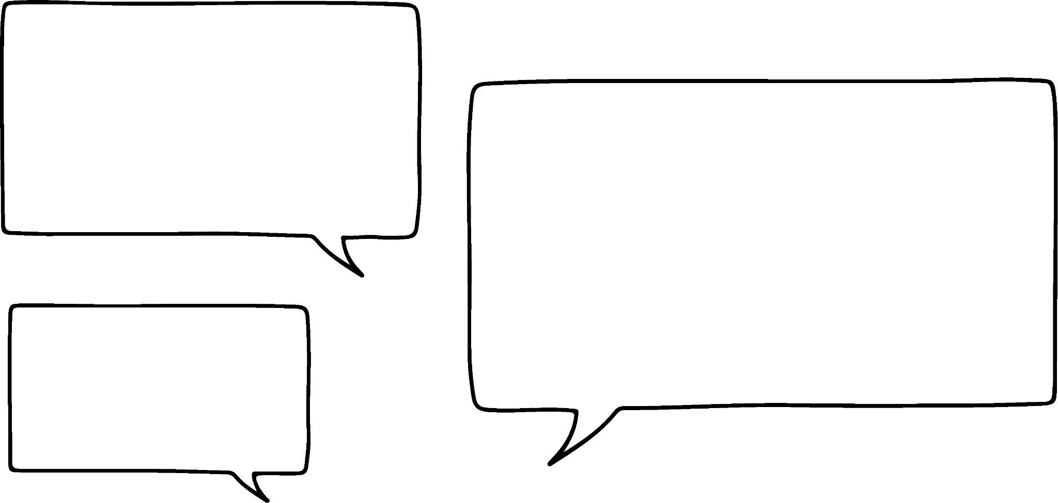
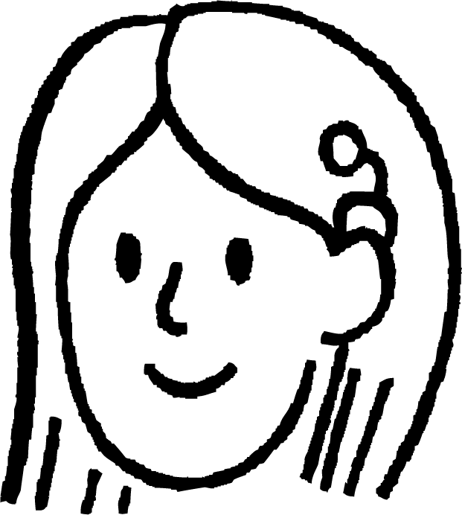

Dealing with an unrepresentative mean
What is the mean of this data set?
4 | 4 | 4 | 6 | 6 | 7 | 7 | 7 | 22 | 22 | 22
The mean is 27.75
Who is correct – Sofia or Laura?
Laura is correct.
Sofia
None of the averages can have a value greater than the largest data point, or less than the smallest data point.
The mean must lie somewhere between 4 and 22 on this dot plot.
That makes no sense!
27.75 is bigger than all the data points!
Laura

Slide 22
Dealing with an unrepresentative mean
What is the mean of this data set?
4 | 4 | 4 | 6 | 6 | 7 | 7 | 7 | 22 | 22 | 22
I divided by 4 because there are four columns of data on the dot plot.
Sofia shows her method.
Sofia
This is wrong. You still need to divide by 11, as there are 11 dots on the dot plot!
At what step in her method did Sofia go wrong?
Laura

Slide 23
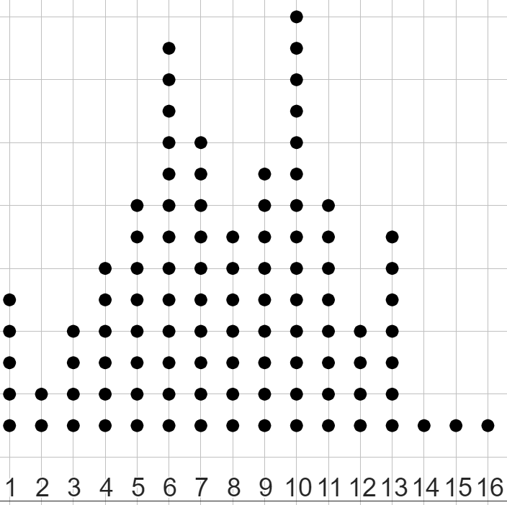
Dealing with an unrepresentative mean
Three of the five values below show the averages for this dot plot.
Which values do not represent an average, and why?
a
8
16
b
c
7.82
10
e
49
d
49 is bigger than the maximum value in the data set. 16 is the maximum value, with a low frequency of 1.

Slide 24
Dealing with an unrepresentative mean
1) Match the mean to each data set.
mean = −3
a)
2 | 2 | 2 | 4 | 6 | 7 | 7 | 9 | 15
mean = 0
b)
−4 | −3 | −3 | −3 | −1 | 2 | 3 | 3 | 6
mean = 6
c)
6 | 7 | 7 | 8 | 10 | 10 | 32 | 32
mean = 14
2)
a) Calculate the mean of this data set.
b) Explain whether the mean is a representative summary of the data set or not.
11 | 11 | 11 | 49 | 51 | 51 | 51 | 51 | 51 | 53

Slide 25
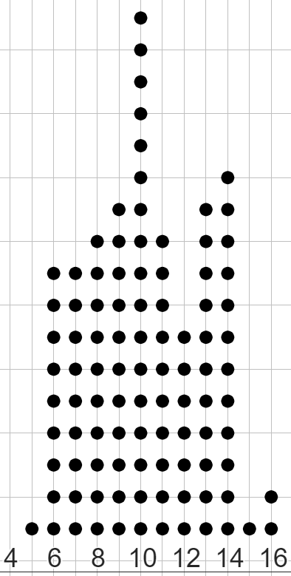
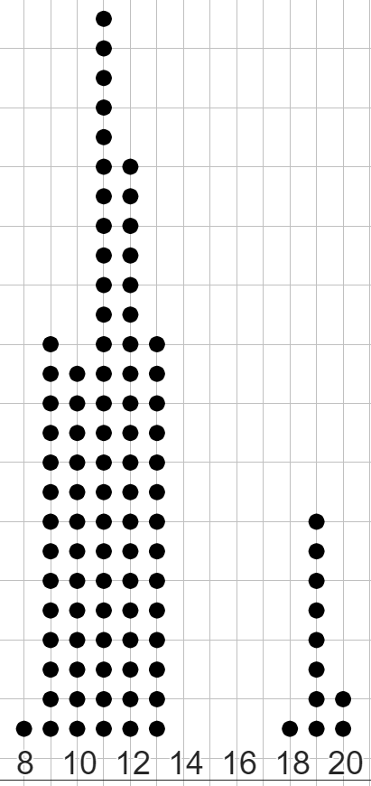
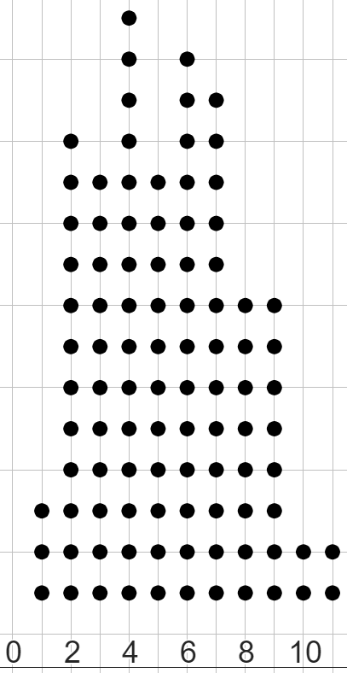
Dealing with an unrepresentative mean
3) Match the mean to each dot plot.
mean = 5.3
a)
b)
c)
mean = 10.2
mean = 11.9
mean = 17.1

Slide 26
Dealing with an unrepresentative mean
1) Match the mean to each data set.
mean = −3
a)
2 | 2 | 2 | 4 | 6 | 7 | 7 | 9 | 15
mean = 0
b)
−4 | −3 | −3 | −3 | −1 | 2 | 3 | 3 | 6
mean = 6
c)
6 | 7 | 7 | 8 | 10 | 10 | 32 | 32
mean = 14
2)
a) Calculate the mean of this data set.
b) Explain whether the mean is a representative summary of the data set or not.
11 | 11 | 11 | 49 | 51 | 51 | 51 | 51 | 51 | 53
mean = 39
No, as 39 is neither near the centre of the data set, nor is it close to any data points.

Slide 27
Dealing with an unrepresentative mean
3) Match the mean to each dot plot.
a)
mean = 10.2
b)
mean = 11.9
c)
mean = 5.3

Slide 28
Summarising data
Calculating all of the averages
Dealing with an unrepresentative mean
Dealing with an unrepresentative median or mode

Slide 29
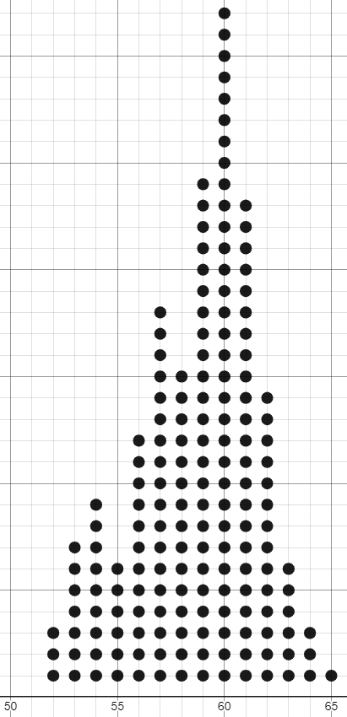
Dealing with an unrepresentative median or mode
An advantage of the mode is:
If a mode exists, it is usually easy to spot.
Calculating the mean or median for this 173 element data set would take a long time.
But even without knowing the value of the data, you can see the mode is here.
60

Slide 30
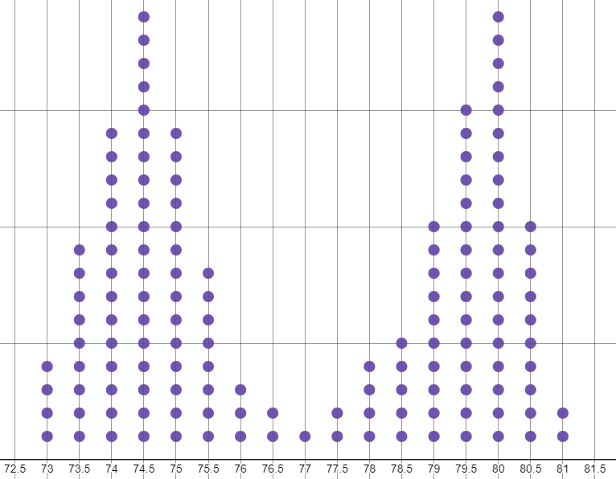
Dealing with an unrepresentative median or mode
The mode can be useful if the data set is distinctly bimodal:
This data set has two distinct modes that are relatively far apart in the data.
None of the other averages summarise a data set using two (or more) values.
This data set is bimodal at 74.5 and 80.
74.5
80

Slide 31
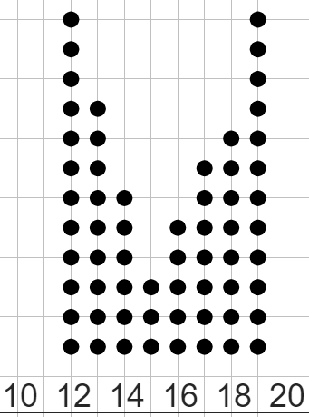
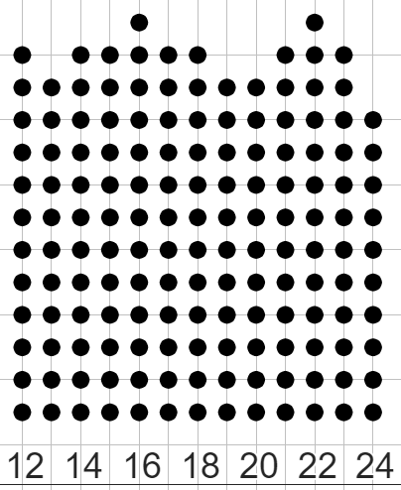
Dealing with an unrepresentative median or mode
However, the mode may not as effectively represent the data if the modal frequency isn’t much higher than some of the other values in the data set.
This data set is clearly bimodal at 12 and 19.
12 and 19 both represent the distinct peaks of the data set.
This data set is bimodal at 16 and 22.
However, 16 and 22 barely have a frequency greater than many other data points.
These modes do not represent any distinct peaks in the data, or a frequency much higher than any other value.

Slide 32
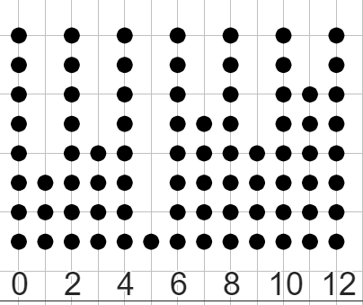
Dealing with an unrepresentative median or mode
This is also true for data sets with too many modes.
Is there any significance in representing the data by several values?
This data set has modes at: 0, 2, 4, 6, 8, 10, and 12.
These modes do not represent any distinct peaks in the data, or a frequency much higher than any other value.
If the data set has more than 3 modes (trimodal), it is usually best to not summarise using the mode.
Is it really a summary if we try to represent the data set with 7 modes?

Slide 33
Dealing with an unrepresentative median or mode
Another advantage of the mode is:
It is the only one of these three averages that can be used to summarise qualitative data.
PINK | PINK | PINK | PINK | PINK | BLUE | BLUE | BLUE | GREEN | GREEN | GREEN | PURPLE | PURPLE
The mean is impossible because you can’t add colours, whilst there is no defined order to make finding the median value possible.
The mode is clear to see; the most frequently occurring colour is pink.

Slide 34
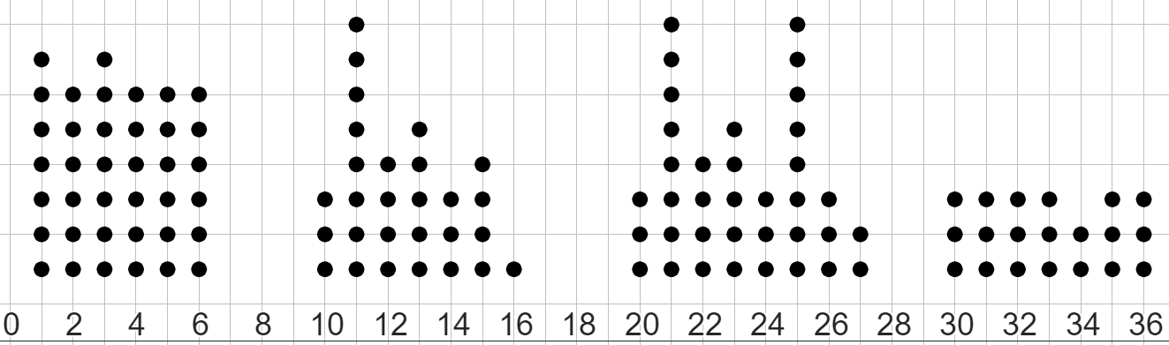
Dealing with an unrepresentative median or mode
Match the dot plot to the statement about its mode.
a
b
c
d
It has a single mode which is representative
No mode
It has two modes (bimodal), but they aren’t very representative
It has two modes (bimodal) which are both representative

Slide 35
Dealing with an unrepresentative median or mode
Match the dot plot to the statement about its mode.
a
b
c
d
3)
2)
4)
1)
It has two modes (bimodal), but they aren’t very representative
It has a single mode which is representative
It has two modes (bimodal) which are both representative
No mode

Slide 36
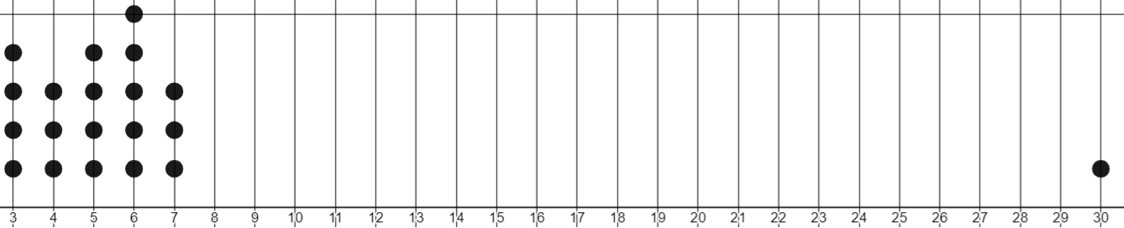
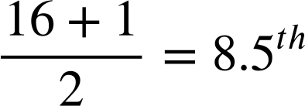


Dealing with an unrepresentative median or mode
Where would the median be on this dot plot?
There are 16 data points, so the median will be the
This will be in between the 8th and 9th data points.
data point.
The median will be around 16, since that’s the middle of the number line being used.
The median will be 6, since that’s the middle data point, no matter how spread out the data is.
Aisha
Lucas

Slide 37
Dealing with an unrepresentative median or mode
Where would the median be on this dot plot?
The median will be around 16, since that’s the middle of the number line being used.
The median will be 6, since that’s the middle data point, no matter how spread out the data is.
Aisha
Lucas

Slide 38
Dealing with an unrepresentative median or mode
Where would the median be on this dot plot?
Lucas is correct.
The benefit of the median is that it will represent a central value of an ordered data set most of the time, no matter how spread out a data set is, or how extremely small or large some of its data points are.
The median will be 6, since that’s the middle data point, no matter how spread out the data is.
Lucas

Slide 39
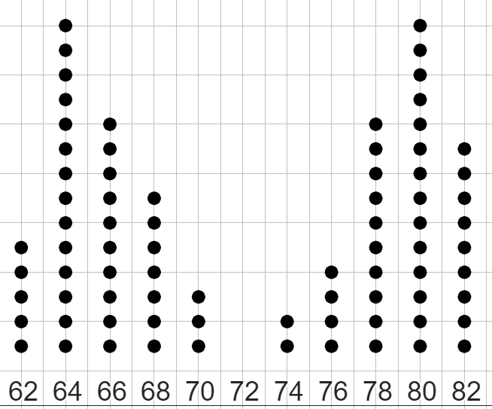
Dealing with an unrepresentative median or mode
Whose statement is correct for this dotplot?
The mode is a representative summary, as the data set is distinctly bimodal at 64 and 80.
The median is not a representative summary of this data set, as the median of 72 isn’t even a data point!
Oh, and it also isn’t close to many frequent values!
Aisha
They are both correct!
Sometimes, one summary is far more representative than a different one.
Lucas

Slide 40
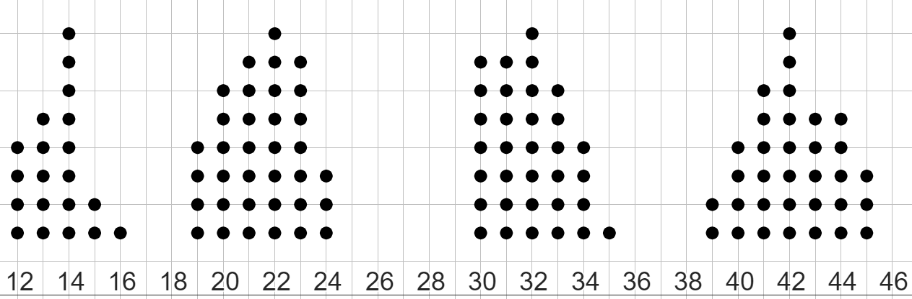
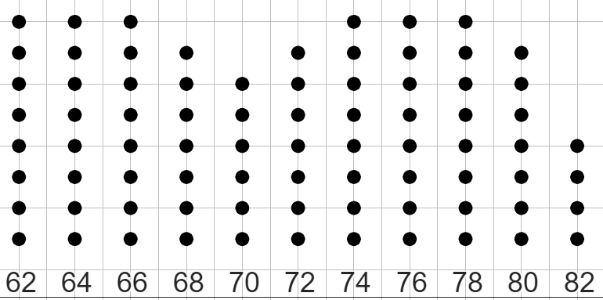
Dealing with an unrepresentative median or mode
Match the dot plot to the statement about its median and mode.
a
median = 20
b
median = 37
c
median = 72
Its mode is a more representative summary than its median, and it is bimodal.
Its median is a representative summary, and it has no mode.
Both its median and its mode are representative summaries, and it is bimodal.

Slide 41
Dealing with an unrepresentative median or mode
Match the dot plot to the statement about its median and mode.
3)
1)
2)
a
median = 20
b
median = 37
c
median = 72
Its mode is a more representative summary than its median, and it is bimodal.
Its median is a representative summary, and it has no mode.
Both its median and its mode are representative summaries, and it is bimodal.

Slide 42
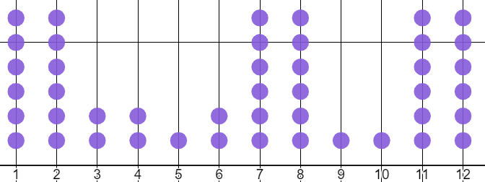
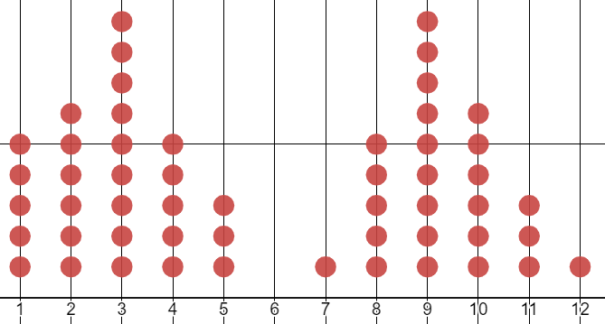
Dealing with an unrepresentative median or mode
1) For which one of these data sets is the median the more representative summary, and for which one is the mode the more representative summary?
You must write one sentence why you chose that one over the other.
median = 7
median = 6

Slide 43
Dealing with an unrepresentative median or mode
data set 1
1 | 2 | 3 | 3 | 3 | 3 | 3 | 3 | 3 | 3 | 4 | 6 | 9 | 57
data set 2
2 | 2 | 2 | 3 | 4 | 4 | 4 | 5 | 5 | 6 | 6 | 6 | 8
2) Answer parts a, b, and c for both these data sets.
a) Calculate the mean, median, and mode for this data set.
b) Which averages do you think are the most representative summaries of this data set?
c) What benefit might there be to still using the average that is least representative?

Slide 44
Dealing with an unrepresentative median or mode
1) For which one of these data sets is the median the more representative summary, and for which one is the mode the more representative summary?
You must write one sentence why you chose that one over the other.
median = 7
median = 6
The mode is more representative. This is because the median is not near any high-frequency values.
The median is more representative. This is because there is no mode.

Slide 45
Dealing with an unrepresentative median or mode
data set 1
1 | 2 | 3 | 3 | 3 | 3 | 3 | 3 | 3 | 3 | 4 | 6 | 9 | 57
2a) mean ≈ 7.4 median = 3 mode = 3
b) The median and mode are the most representative summaries. This is because they are both similar in value. 3 is by far the most frequent value, and is also the value in the middle of the data.
c)The mean may still be useful because it shows how unbalanced the data points are. If all the values of the data points were added together and evenly distributed, then the value of many data points would change a lot.

Slide 46
Dealing with an unrepresentative median or mode
data set 2
2 | 2 | 2 | 3 | 4 | 4 | 4 | 5 | 5 | 6 | 6 | 6 | 8
2a) mean ≈ 4.4 median = 4 mode = trimodal at 2, 4, 6
b) The median and mean are the most representative summaries. This is because they are both similar and represent data points close to the centre of the data set.
c)The data set being trimodal means each mode may lose its significance, but it does show the data set does not have any value that is far more frequent than the others.

Slide 47
Summarising data
Acknowledging that the mean, median, and mode are all different summaries of data, and each can take on the same or different values to the others.
Understanding that sometimes the value of an average may deviate away from the other values. This is okay, as long as it has been calculated correctly.
Some averages may be more representative as summaries than others, and it is important to identify the representative averages for a given data set.
Acknowledging that an unrepresentative summary may still have usefulness to the data set is an important part of considering the averages.

Slide 48

© Oak National Academy 2023.
Produced in partnership with Mathematics in Education and Industry.
Licensed on the Open Government Licence v3.0, except where otherwise stated. See Oak terms and conditions.

